Slide 1
JOINT STAFF J-7
JTLS-GO International Users Conference March 2024
Jessica L. Camacho, CIV
JTLS-GO Program Manager
Suffolk, VA
Phone: (757) 203-5164
Email: Jessica.L.Camacho.civ@mail.mil
Jason D. Ayres, CTR
JTLS-GO Product Manager
Suffolk, VA
Phone: (757) 203-9074
Email: Jason.D.Ayres.ctr@mail.mil

Slide 2
Agenda
JS J-7 Mission
Environment Operations Division
JTLS-GO Program Management
How We Use JTLS-GO
Future JTLS-GO Events at JS J-7

Slide 3
Joint Staff J-7 Mission
​The Joint Staff J-7, in support of the Chairman, trains, educates, develops, designs and adapts the globally integrated, partnered, joint force to achieve overmatch in the continuum of conflict under conditions of accelerating change in the character of war.​
Preparing the Joint force to deter, defend, & prevail

Slide 4
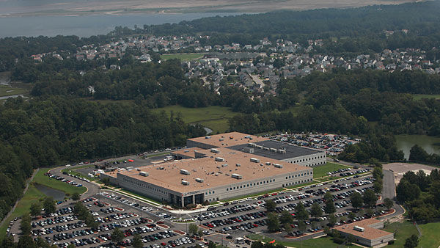
Environment Operations Division
EOD: Provides technical enablers, training support and expertise to deliver realistic Joint Training content and context in support of the Joint Force.
Simulations to create a realistic environment
Networks to deliver content to the point of need
Infrastructure to enable all phases of exercise planning & execution
Cybersecurity
Development
4

Slide 5
JTLS-GO Program Management
Provide a flexible, scalable and deployable simulation for DOD organizations and multinational partners to conduct effective training.
Maintain a stable, reliable, available system that meets cybersecurity requirements. Cyber accreditation done on site at JS J7 facility.
Provide and vet requirements so JTLS-GO is relevant in the joint training ecosystem.
Issue Standard Use and Distribution Agreements (SUDAs) to U.S. government organizations.
Share ideas, thoughts and experiences among users.
5
Notes:
Maintain a stable, reliable, available system that meets cybersecurity requirements.
Conduct cybersecurity scans at JS J7 facility.
Provide timely fixes to software deficiencies and bugs.
3
- Review Engineering Change Proposals (ECP) and Software Trouble Reports (STR).

Slide 6
How We Use JTLS-GO
  Standalone solution to run all exercise facets
  Federation capability
    MUSE/AFSERS
  Supported Tiers
    I – Combatant Command and Higher
    II – Joint Task Forces
    III – Functional Components
6

Slide 7
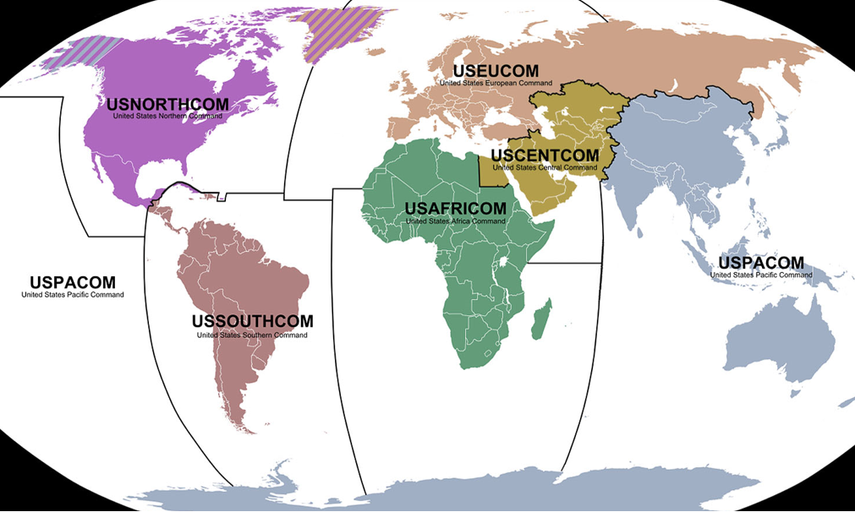
DDJT FY24 Joint Event Support
STRATCOM
GLOBAL LIGHTNING 24
EUCOM
AUSTERE CHALLENGE 24
AVENGER TRIAD 24
JACKAL STONE 24
NORTHCOM
VIGILANT SHIELD 24
ARTIC EDGE 24
NUWAIX
VITAL ARCHER 24
SOCOM
CWMD SLS 24-1
BRONZE RAM 24
ABLE WARRIOR 24
CSOJTF-LEVANT 24
CSOJTF CENTRAL 24
JTF HQ
SCARLET DRAGON 7
CENTCOM
INTERNAL LOOK 24
JUNIPER COBRA 24
REGIONAL COOPERATION 24
EAGER LION 24
INVINCIBLE SENTRY 24
TRANSCOM
TURBO CHALLENGE 24
ULTIMATE CADUCEUS 24
AFRICOM
JUDICIOUS RESPONSE 24-1
JUDICIOUS RESPONSE 24-2
AFRICAN LION 24-1
AFRICAN LION 24-3
JUDICIOUS WARRIOR 24
EPIC GUARDIAN 24
L
INDOPACOM
KEEN EDGE 24
COBRA GOLD 24
BALIKATAN 24
TEMPEST WIND 24
SOUTHCOM
PANAMAX 24
TRADEWINDS 24
CENTAM GUARDIAN 24
RESOLUTE SENTINEL 24
FUSED RESPONSE 24
INTEGRATED ADVANCE 25
SPACECOM
NIMBLE TITAN 24
APOLLO GRIFFIN 24
USFK
ULCHI FREEDOM SHIELD 24
CYBERCOM
CYBER GUARD 24
CYBER FLAG 24
JCS
CAPSTONE x 4
PINNACLE x 2
KEYSTONE x 2
GIE 24
GIWG 24
*Highlighted exercises use JTLS-GO
7

Slide 8
Future JTLS-GO Events at JS J-7
Continued programmatic support
Upcoming Testing & Demo Events
  May 2024
    Operational Assessment Testing ver 6.2
    Demonstration of ver 6.3
    Demonstration of JTLS-GO ingesting OBS data from JTDS
  June/July 2024
    PANAMAX Event Function Test (EFT)
    PANAMAX Event Operational Test (EOT)
  August 2024
    PANAMAX 24 execution
8

Slide 9
Questions?
Jessica L. Camacho
JTLS-GO Program Manager
Environment Operations Division
Jessica.L.Camacho.civ@mail.mil
Phone: +1 (757) 203-5164
Jason Ayres
JTLS-GO Project Manager
Huntington Ingalls Industries
Jason.D.Ayres.ctr@mail.mil
Phone: +1 (757) 203-9074

