Slide 1
JTLS-GO 6.3 Current Status
Ellen F Roland
JTLS-GO Director Of Development

Slide 2
JTLS-GO 6.3 Status
Non-Traditional Test Schedule
Week 29 April
Training Test Session
Week 13 May
JS/J7 Beta Test / Demonstration
Beta Version Loaded On JTLS-GO International Test Site
www.jtlsgo.com
JTLS-GO 6.2 Virtual Training Scheduled For 8 to 10 May
When That Is Finished, Move In JTLS-GO 6.3
6 June To 19 June
NATO Full Test Session At CWIX
Official Release 29 June

Slide 3
JTLS-GO 6.3 Status
Week Of 2 September
NATO Operational Assessment Test (OAT)
Week Of 7 September
Possible Training Related Test
Week Of 23 September
NATO Database Test
Week Of 7 October
Training Related Test
First Exercise Use – Mid-October

Slide 4
Operating System
Current Plan Is RedHat 9.3
Defense Information System Agency (DISA) Approved
Security Technical Implication Guide (STIG) Exists
Enhanced Security Library
For All Practical Purposes
Not Backwards Compatible
Not Impossible, But Limited (If Any) Such Testing
Full Range Internal Testing Almost Complete
Demonstrations This Week Will Be On RedHat 8.7

Slide 5
PostgreSQL
JTLS-GO 6.2 Uses PostgreSQL 11
This Version Is No Longer Supported
Thus, No Longer Meets DISA STIG Requirement
Working On Plan of Action And Milestone (POA&M)
For JTLS 6.2 Waiver
JTLS-GO 6.3 Will Use PostgreSQL 15
Current Version is PostgreSQL 15.6
Supported Until 11 November 2027
Will Use PostgreSQL 15 from www.postgresql.org
PostgreSQL Edge Containerized Solution Is No Longer Free

Slide 6
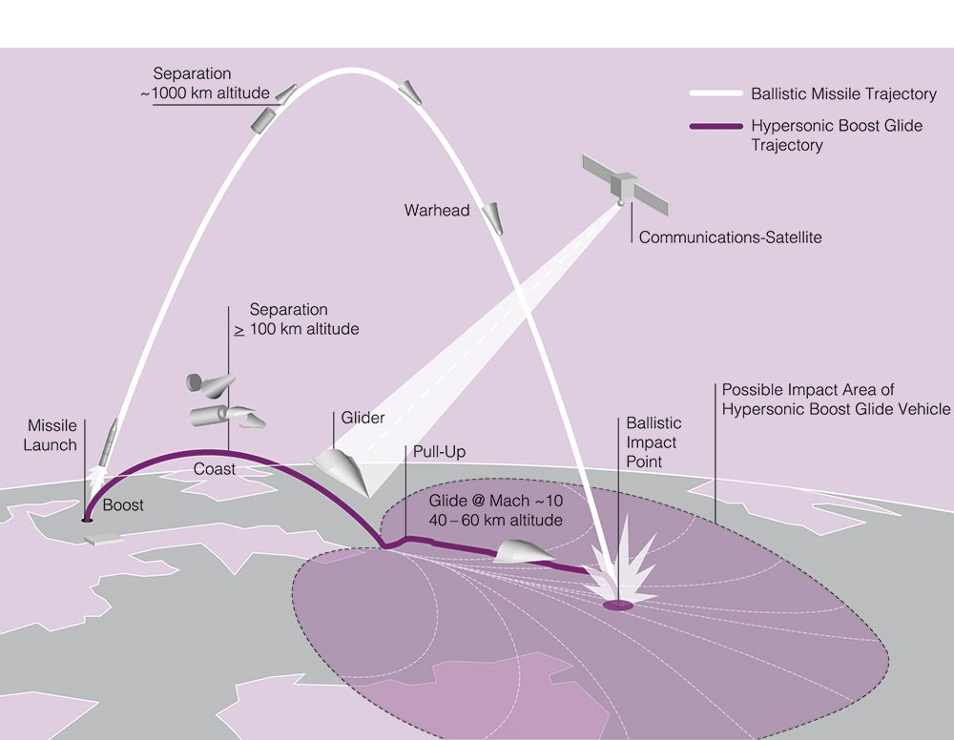
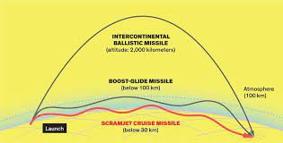
Hypersonic Weapon Representation
Design Has Changed Throughout The Year
First Design Went With Information Cannot Be Interdicted
Ukraine Has Proven That Not To Be True
Better Representation Of Cruise Missile, Ballistic Missile, and Boost Glide Missile
Boost Glide
Ballistic
Cruise

Slide 7
Hypersonic Weapon Representation (Con’t)
Modeled Capabilities
New Targetable Weapon Data
Type Of Weapon – Cruise, Ballistic, Boost Glide
Minimum Range – Cannot Be Fired At Target Closer Than Range
Number Boost Phases
One Is Equivalent To Current Ballistic Missile
More Than One - Equally Distributed Along Flight Path
Boost Time Removed – Now Computed
Boost Phase Interdiction
Yes – Can Be Used To Interdict Missile During Boost Phase
Kill – Results In Kill
Hit / No Kill – Results In Off Course Impact
No – Cannot Be Used To Interdict Missile During Boost Phase
Both – Can Be Used Throughout Flight Path – Not Expected But Feasible
Currently No Separate Data

Slide 8
Hypersonic Weapon Representation (Con’t)
Modeled Capabilities (Con’t)
Current Air Defense Data Has
Range By Altitude Zone
Maximum Range Versus Missiles – Used For Interdiction Of
Cruise Missiles
Ballistic Missiles
Changed To
Range By Altitude Zone - Used For
Aircraft
Cruise Missiles
Maximum Range Versus Missiles
Used Against Ballistic Missiles
Maximum Range Versus Hypersonic Missiles
Used Against Boost Glide Missiles

Slide 9
Hypersonic Weapon Representation (Con’t)
Modeled Capabilities
Cruise Missiles
Can Be Intercepted By Aircraft
Can Be Fired On By Aircraft and Air Defense
C4I
OTH-Gold – Indicates Air Object
Link-16 – Tracks Use J 3.2 Message

Slide 10
Hypersonic Weapon Representation (Con’t)
Modeled Capabilities (Con’t)
Ballistic Missiles
Cannot Be Intercepted By Aircraft
Can Be Fired On By Aircraft And Air Defense
Remember Capability Is Data. - Keep Model Unclassified
C4I
OTH-Gold – Indicates Space Object
Link-16 – Tracks Use J 3.6 Message

Slide 11
Hypersonic Weapon Representation (Con’t)
Modeled Capabilities (Con’t)
Boost Glide Missiles
Cannot Be Intercepted By Aircraft
Can Be Fired On By Aircraft And Air Defense
Remember Capability Is Data. - Keep Model Unclassified
C4I
OTH-Gold – Indicates Space Object
Link-16 – Tracks Use J 3.6 Message

Slide 12
Improve Satellite Representation
Represent Satellite Altitude
Currently All Satellites Assumed To Be At 100,000 Feet
New Capability
Satellite Altitude Represented
JSAT Program Computes This Based On Two-Line Entry Data
Added To Repository New Altitude Zones
Lower Earth Orbit
Mid Earth Orbit
Geosynchronous Orbit
High Earth Orbit
Implies Data Exists For Air Defense Site Ability To Interdict

Slide 13
Improve Satellite Representation (Con’t)
Represent Types Of Satellites
Size Has Relationship To Ability To Interdict.
By Air Defense Sites
By Aircraft
Each Satellite Has An Assigned Aircraft Target Class
Allows Entry Of PH/PK Data For Interdiction Algorithms
New Aircraft Target Class Attribute
Radius Of Debris Field
Used Only For Killed Satellites
Catastrophic Kill Time Used To Determine When To Delete Debris Field
When Any Satellite Enters Debris Field
Not Damaged
Sensor Collection Inactive

Slide 14
Improve Satellite Representation (Con’t)
Representation Of Space To Surface Kinetics
Put Weapons On A Satellite – They Work
You Put a 20MM Gun On The Satellite – It Works
Provide A Satellite Task To Fire Weapon
When With Range Of Target / Unit – Weapon Fires.
No Rules Of Engagement (ROE) Needed
User Provides The Task
The Weapon Is In Range
The Weapon Is Fired
No Automatic Firing Because There Is No ROE
No Space To Air Firing Allowed

Slide 15
Exercise Log
Create A Web-Based Exercise Log
Technical Control Can Inform Users Of Issues
Users Can Ask Questions
Helps With Turn Over Task
Read What Happened During Off Shift
Automatic Exercise Log Entries
Order Panel – Click “Log” Button – Creates Log Entry
Use Case: Remember To Make This Data Change In Database Post Exercise
Air Tasking Order - Translator (ATO-T) – Click Problem Missions
Use Case: Leave Message For Day Shift To Look At Selected Missions Because the ATO-T Has A Problem With The Mission

Slide 16
Receive Data From JTDS
JS/J7 Joint Tactical Data System
Use Order of Battle XML File
Read The Data
Convert It To JTLS-GO Scenario
Limited Testing
Plans To Expand Usefulness As Capability Is Demonstrated.
Personal Opinion
JLVC Improvement Program Is Important To JS/J7
JTLS-GO Could Leverage Ability To
Obtain Live Data
Link With Several Real-World C4I Systems Such As Advanced Field Artillery Tactical Data System (AFATDS)
Not Convinced Using JTDS To Building Scenario Data Will Come To Fruition

Slide 17
Represent Dual Air Search / Surface Search Sensors
Currently
Capability Is Represented As Two Sensors
One Is Destroyed – Other Capability Remains
Takes Controller Action To Solve This Problem
More Memory / Time When
Putting Down Grid Tags For Two Sensor
Improvement
New Data ST Capability Mask
One Sensor Multiple Capabilities
When Destroyed All Capabilities Do Not Function
When Repaired All Capabilities Function
Saves Memory and Time Required To Manage Grid Tags

Slide 18
Improve Controller Set Load Assignment Array
Current Capability
Controller Can Only Change One Cell Of Assignment Array Per Order
New Capability
Allow Ability To Change Multiple Cells Per Order

Slide 19
Leave Formation Order
Current Capability
If A Ship Is Given An Individual Task
It Leaves The Formation If It Is Not Needed
Users Don’t Understand This
Formations Unexpectedly Leave Ships Behone
New Capability
New Task – Leave Formation
Ship Does Not Accept Individual Ship Task If In A Formation

Slide 20
Improve Event Handling In ELS
Improves Reliability Of Els
Talk With Donna If Interested In Details

Slide 21
Improve Structure of DDS And AAR Reports
Using New Table Presentation Libraries
Improving Report-by-Report
All Reports May Not Be Done, For Initial Release
Will Be Completed and Included in Debug / Maintenance Releases

Slide 22
Time Of Expected Fuel Exhaustion On IMT
Model Computes the Time
New Data Column Added To Air Mission IMT

Slide 23
Single Situation Report For Multiple Units
Suggestion From An Exercise Last Year
It Was A Good ECP For A New Programmers
Implemented As Training Requirements

Slide 24
Situation Rollup Report
Provide A Situation Rollup Report
Reprot Includes A Percent Capable For Unit And Subordinates.
Design Explains Algorithm In Detail
Use Case: Provide Capability Of A Brigade
Considers the Combat Systems Owned By
Brigade HQ
Battalions
Companies If Represented
Support Units Attached To Brigade HQ

Slide 25
Put Maintenance / Repair Data In AAR
The Data Has Been Defined
Tracked For Combat Systems (Including Aircraft) And Targets
Maintenance
Time When Entering Maintenance
Reason For Entering Maintenance
Repair
Time Leaving Maintenance
Cannot Link Start And Complete Maintenance For Specific System
JTLS-GO Does Nore Represent Tail Numbers, Vehicle IDs Etc.
Do Need To Discuss How The Data Will Be Used
In Other Words, What Type Of Reports Are Desired.

Slide 26
Air Mission Special Flags
NATO Required Capability
Automatic Special Flag Setting For Link-16 Tracks
Based On Geographic Location Of Mission
Side That Owns The Mission
Mission Type

Slide 27
Improve Range Rings For Units
Current Capability
Unit Shows Unit Capability Range Rings
Need To Display Targets To View Target Range Rings
New Capability
Unit Range Ring Menu Included Ability to Display Owned Target Range Rings

Slide 28
Copy Location From Map
Difficult To Copy Map Locations To Include In
Spreadsheets
PowerPoint Presentations
Documents
Exercise Log
Right Click And Select Location Format
Placed In Clipboard
Use Standard “Paste” Capability Into Other Applications

Slide 29
TPFDD Several Units
Current Capability
Implemented TPFDD In / Out Of Theater For Hierarchy
No Easy Way To TPFDD Several Non-Hierarchy Units
New Capability
Implement Expanded TPFDD IMT Screen
Has All Needed TPFDD Data
Select Multiple Units From TPFDD IMT Screen
Use IMT Spreadsheet Capability To Create
Manage TPFDD Order
Review Spreadsheet
Change As Needed, Such As TPFDD Time
Send Spreadsheet Directly From WHIP.

Slide 30
C4I Naming Flexibility
Add Capability To Alter Names Displayed In C4I
This Is a JTLS-GO Operational Interface (JOI) Function
Discuss With Eric If Interested In Details

Slide 31
Questions / Discussion

