Slide 1
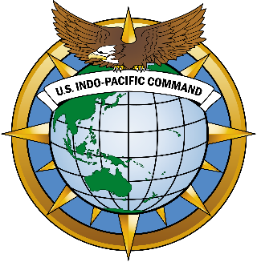
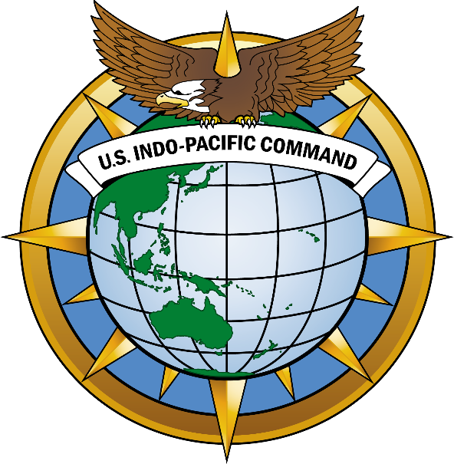
K. Mark Takai Pacific Warfighting Center (KMT-PWC)
UNCLASSIFIED
JOINT FORCE LETHALITY
DESIGN & POSTURE
ALLIES & PARTNERS
EXERCISES, EXPERIMENTATION, & INNOVATION
HQ USINDOPACOM J73
ENSURING A FREE AND OPEN INDO-PACIFIC
Training Across The Pacific
18 March 2024
UNCLASSIFIED
This brief is classified:

Slide 2
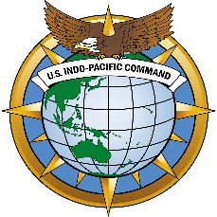
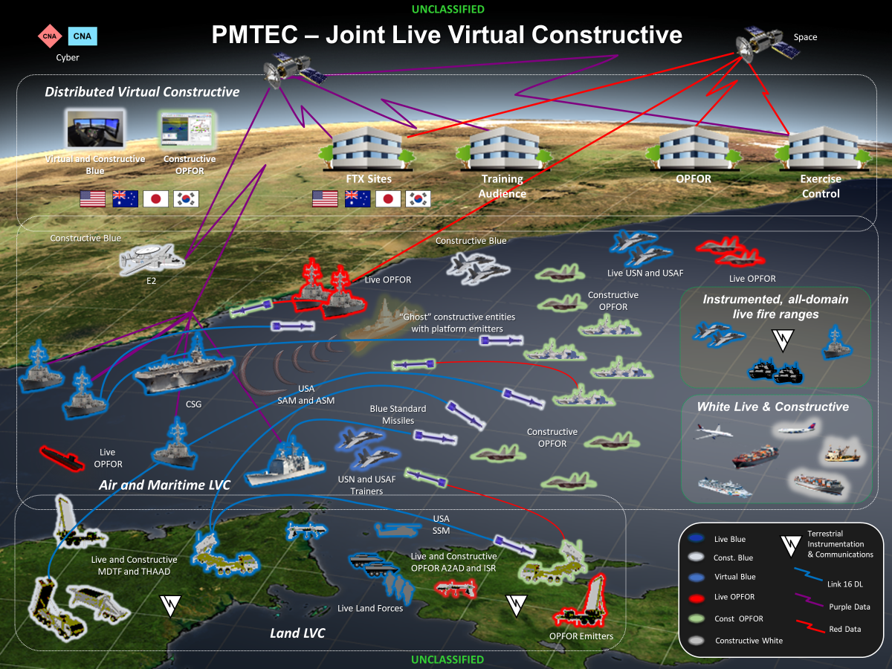
Achieving Multidomain Interoperability
Pacific Multidomain Training and Experimentation Capability

Slide 3
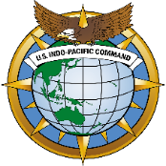
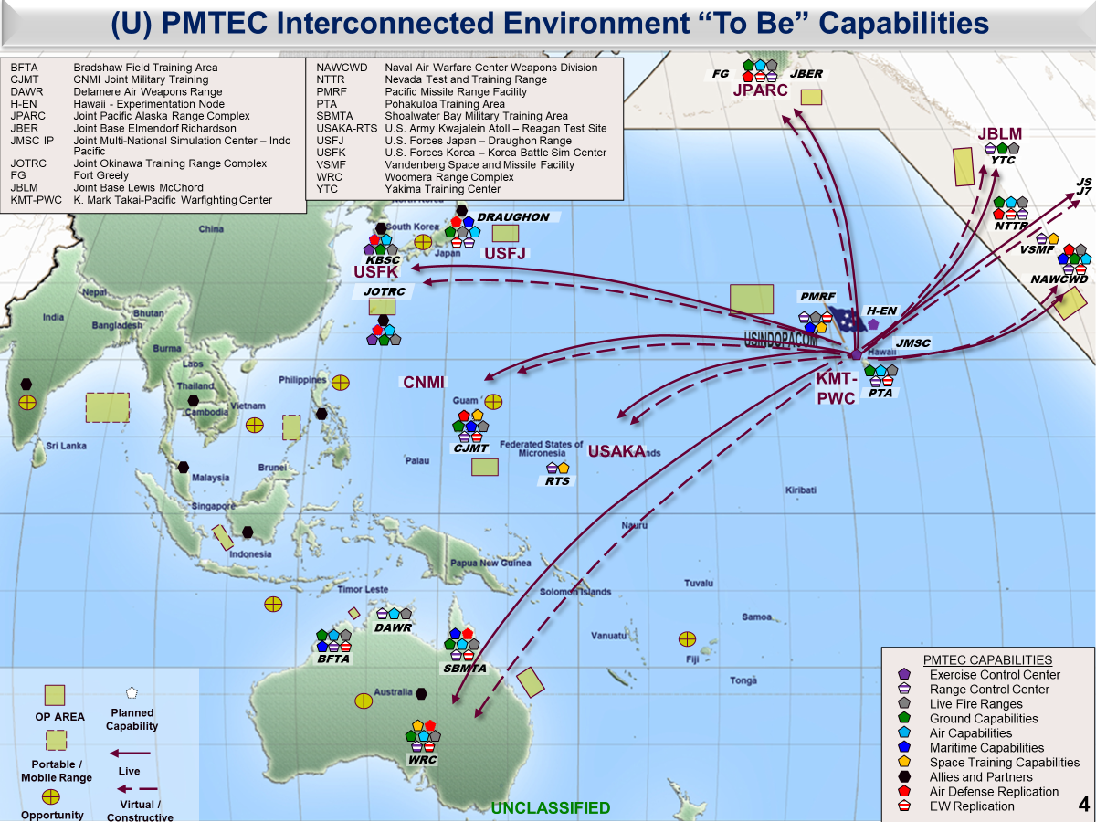
UNCLASSIFIED
Current and Future Initiatives
Live Systems
Networks
//REL Enclaves
Ranges
White Cell
Experiments
Simulations

Slide 4
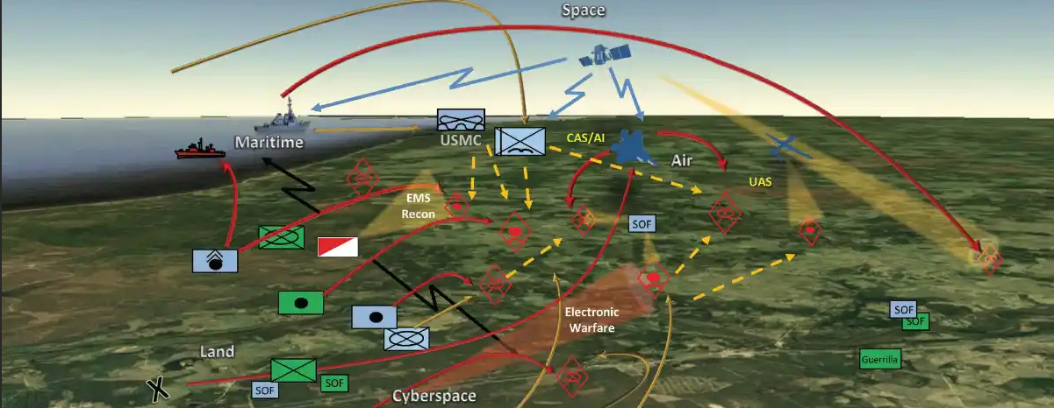
UNCLASSIFIED
Expanding Our Battlespace in 2024
Simulations and Live Systems Integration
Philippines
Japan
Thailand
Live Fires Integration
Augmenting Rehearsals with Sims
Supporting the JTF in the Field
CPX and FTX Direct Support
Live Systems Data Feeds
C4I and COP Distribution
US Data in a REL Environment
Multiple Classification Levels
Deployable Service Kits
CPX Focused Event
Multinational Combined ECG
16 Organizations at 14 Locations
8 Simulations
5 Core Mission Command Systems
3 Classifications of Networks
Fully Distributed Sims ECG
C4I Fusion from Korea to Virginia
Deployable Service Kits
Joint and Combined Nations
CPX and FTX COP Management
Continued PMTEC Integration
In Country ECG Support
FTX Rehearsal Support with Sims
Operating on REL Networks
Enables Commanders to:
Expand their Battle Space by ingesting Simulations into Live Pictures
Rehearse Fires and Effects coordination without ever having to fire a shot
Test emerging capabilities provided by the unit or USINDOPACOM Command
Create resource shortfall solutions by integrating sims into the entire operation
UNCLASSIFIED

Slide 5
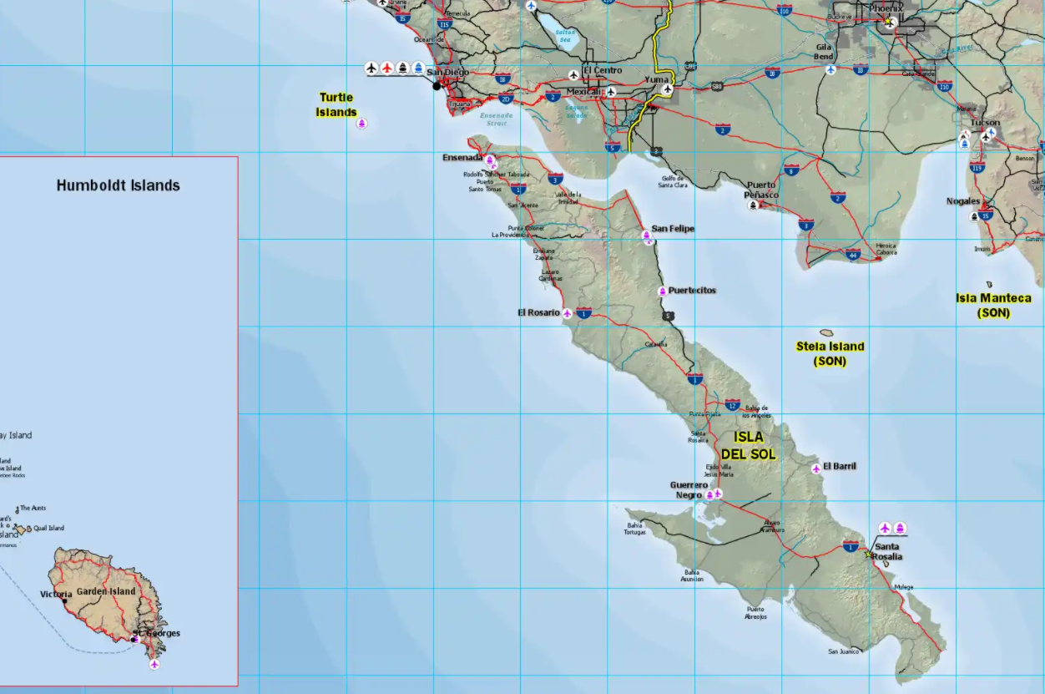
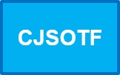
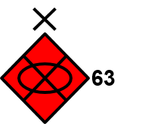
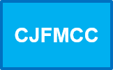
UNCLASSIFIED
Simulations and Planning
Begins: Initiation of surface-to-surface fires on IDS
Ends: CJTF BW prepared to transition to the defense south of PL Idaho; TDO forces withdraw north of PL Idaho
Operations
Decisive: Defeat of 63rd and 64th BTG
Shaping #2: Amphibious Assault
Sustaining: Combat resupply along Axis Victoria
CFLCC (ME)
Task: Attack along Axis Victoria
Purpose: Defeat 63rd and 64th BTG to compel withdrawal of enemy forces north of PL Idaho
CJFMCC (SE1)
Task 1: Amphibious landing
Purpose 1: Deny enemy reinforcement
Task 2: Interdict enemy forces
Purpose 2: Deny reinforcement of the 61st DTG to the 62nd or 63rd DTG IVO PL Alabama
CFACC (SE2)
Task: Air Interdiction and Close Air Support
Purpose: Enable CFLCC freedom of maneuver
CSOTF (SE3)
Task: Degrade enemy combat power IVO PL Idaho
Purpose: Reduce enemy combat strength to reinforce attacks against TF BW forces
Use of JTLS During COA Development
NAI
003
PL Idaho
NAI
002
PL Alabama
PL Montana
PL Virginia
NAI
001
PL Washington
Inform, Confirm, Deny, and Validate Plans
UNCLASSIFIED

Slide 6
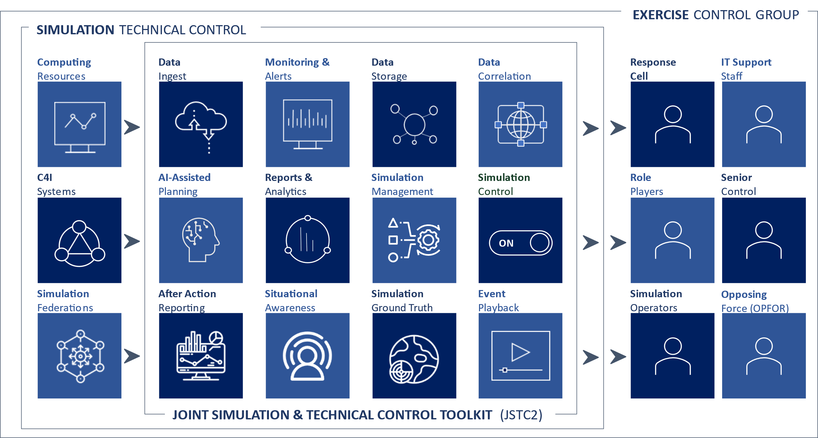
UNCLASSIFIED
Advanced Exercise Control Tools
Increasing Situational Awareness by Reducing Manual Processes
UNCLASSIFIED

