Slide 1
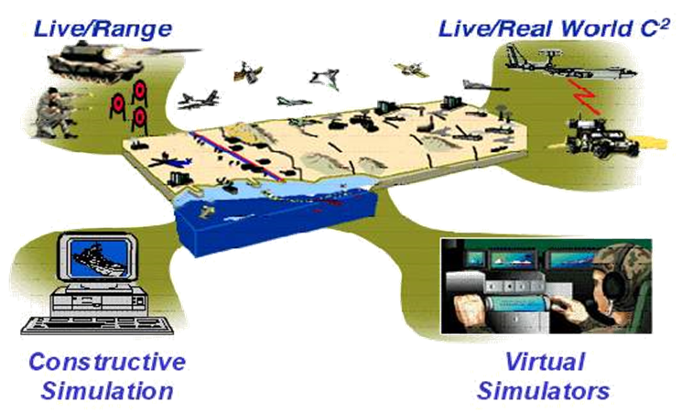
DND/CAF Modelling and Simulation Coordination Office
Version 0.2
As of: Feb 24
2024
Maj Roach
JES MSCO

Slide 2
DND/CAF MODELLING AND SIMULATION COORD OFFICE
Correct as at: Current
MSCO
LEAD
(LCOL/MAJ)
Contractors
Filled
Contractor
M&S Software Eng
Contractor
M&S Software Eng
Dual role
VACANT
3D Modeller
JBL/JOFL LEAD
(MAJ)
OPS LEAD
(MAJ)
MSCO Governance/Policy
MAJ
Tech
Eng 4
JBL/JOFL
Dep
MWO/CPO
OPS
Planner
CAPT
MSCO
Simulation
Standards
Capt
IT 2
IT 2

Slide 3
DND/CAF M&S Policies
Defence Administrative Orders and Directives (DAOD) 2010-0 Modelling and Simulation
Defence Administrative Orders and Directives (DAOD) 2010-1 Modelling and Simulation Management.
DND/CAF Capstone M&S Strategy Feb 2013.
DND/CAF Capstone Roadmap Apr 2016.
Notes:
DAOD 2010-0 Outlines the requirement for M&S in Defence
DAOD 2010-1 Outlines the Governance structure and base responsibilities
Strategy provided the Strategic goals for the Development of M&S as a capability in Defence.

Slide 4
Activities 2024
Version 0.2
As of:
Re-build of the JMSA at CJWC to support L1 organisations, CJOC, CFD, DG Cyber, DG Space, supported by CO CJWC.
Manning review and manning increase to support full MSCO tasking including the support to the JMSA/JOFL. (new Public Service positions)
Reconnection to 5EE and NATO M&S partners.
Participation in the NATO NMSG.
Review and rewrite strategic documents. FY 2024.
Notes:
JMSA - Joint M&S Architecture
5EE - Five EYES

Slide 5
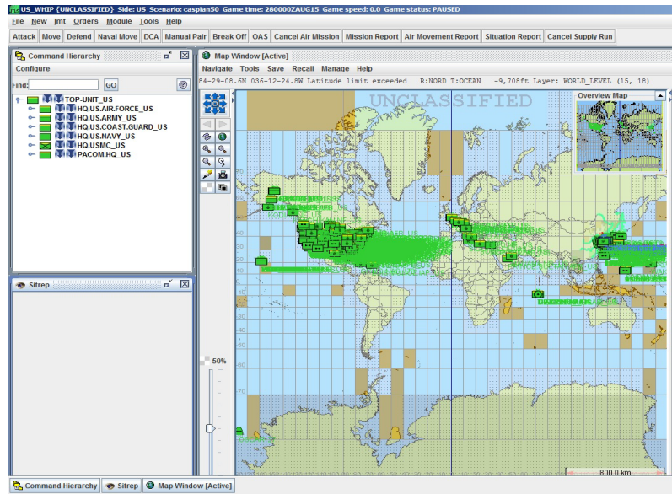
Activities 2024
Version 0.2
As of:
Commenced build of an Unclas test lab in Bld 4, CJWC.
Acceptance of CAF software held by the DLCSPM and the RAWC. Partner with CFD to acquire a Joint Simulation application (JTLS-GO) in FY 23/24
Participation in JOFL development WG for the build in FY 2024.
Continued Participation in the NATO MSG BM.
Conduct of the Synthetic Environment Working Group 12 – 15 Apr 24.
Planned Fall SEWG in Sep 24 and Sim Symposium for Oct 24.
Partner with CFD to acquire a Joint Simulation application (JTLS-GO) in FY 23/24
Notes:
JTLS-GO – Joint Theatre Level Simulation – Global operations (current NATO Sim)
NMSG - NATO Modeling and Simulation Group Business Meeting
SEWG – CAF Synthetic Environment Working Group

Slide 6
Long Term
Version 0.2
As of:
Established Tiger Teams with a Service Lead to support Training and Education for M&S across the CAF.
Standards and standardised practices for the use of M&S in the CAF/DND. Release of the approved and signed CMSSP.
Rewrite of the DAODs, Capstone Strategy and RoadMap with a sign off in 2025.
Push enterprise level software to other services. (JTLS, HIVE, VCCI)
Notes:
CMSSP – Canadian Modelling and Simulation Standards Profile Document.

