Slide 1
JTLS-GO Demonstrations
Ellen F Roland
JTLS-GO Director Of Development

Slide 2
Planned Demos
WHIP Development Office
First Floor – Turn Right
Jane Wu - New DDS Reports
Engineering Conference Room
Second Floor – Turn Right
Harold Yamauchi – AAR Reports
Donna’s Office
Second Floor – Turn Right
Left Of Engineer Conference Room
Explanation Of New OPM

Slide 3
Planned Demos
Zafer’s Office
First Floor – Turn Left – Second Office On Your Left
PostgreSQL 15
Steve’s Office
First Floor – Turn Left – First Office On Your Left
JTLS-GO Exercise Log
Training Room
First Floor – Turn Left – On Your Right
JTLS-GO 6.3 WHIPs For Free Play

Slide 4
Planned Demos
Things To Look At On WHIPs
New Range Ring Access
Exercise Log
Including Automatic Order Log
Controller New Set Load Assignment Order
Multiple Unit Sitrep
Situation Rollup Report
OPAREA Special Mission Flag Assignment
No Way To Currently View Flag Has Been Assigned
Copy Location Into Clip Board

Slide 5
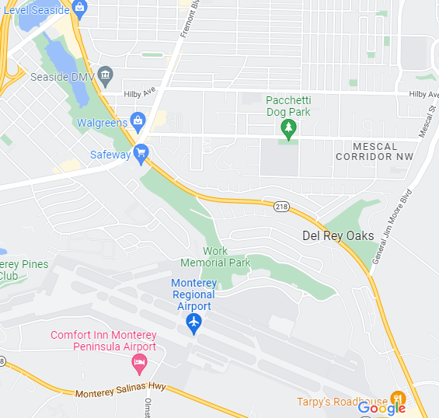
Map To Office
Address: 120 Del Rey Gardens Drive
Embassy
Suites
Safeway

Slide 6
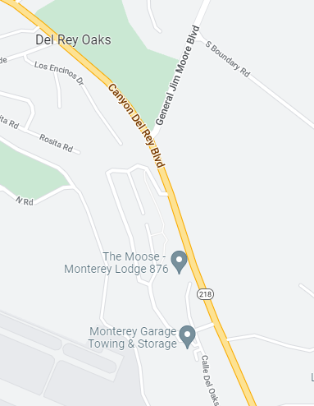
Detailed Map
Stop Light
Second Right

Slide 7
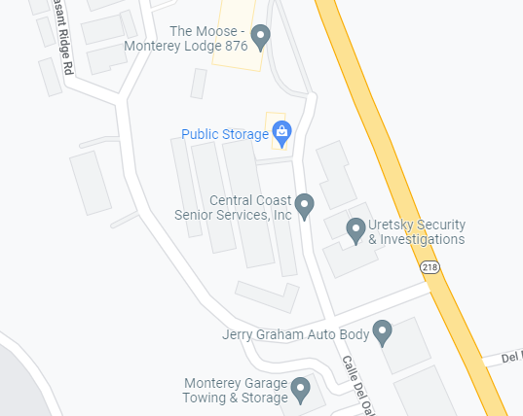
More Detailed Map
Look For The Flag

Slide 8
Questions

