Slide 1
JTLS-GO 6.4 Status
Eric McDonald
Director of Development
JTLS-GO

Slide 2
Non-Traditional Development Schedule
NATO provided significant development money
  Needed several ECPs:
    to address cybersecurity
    for their major Fall exercises
    that require data changes
    that affect system design
    triggers need for cybersecurity testing
JS/J7 Research Project
  ECPs that require breaking data changes

Slide 3
Basic Plan
Delivery divided into 3 phases
  Phase 1 - JTLS-GO 6.3.4 – Completed in February
    Meet cybersecurity test requirements
    Delivered as JTLS-GO 6.3.4
  Phase 2 – JTLS-GO 6.3.5 - To be completed by May
    Non-data ECPs needed for NATO’s Fall exercises
    No major system changes
    No need to retest for cybersecurity
  Phase 3 – JTLS-GO 6.4 - To be completed by June
    ECPs requiring data changes
    ECPs with system changes
    Must retest for cybersecurity

Slide 4
Phase 1 – JTLS-GO 6.3.4
Completed in February
Consisted of:
  Three cybersecurity ECPs
    Encrypted DDS Passwords
    DDS Client Permissions
    Trusted User Environment
  One simple, functional ECP
    Deterministic Damage Combat System order

Slide 5

Encrypted DDS Passwords
Similar to WHIP passwords in 6.3
  Assign default password in DCP
  Passwords saved in encrypted format
  Users forced to reset password on first login
  Only that user knows the password
Ensure data changes are accountable
  DDS logs changes made by each user
  Organizations needs to enforce a password policy

Slide 6

DDS User Permissions
Technical Control can control permissions for each DDS User
  Was a cybersecurity issue
  Useful operationally
5 Levels of Permissions
  #1 Download Database to Scenario Files
    Downloads are inherently a destructive process
    Old scenario files are overwritten
  #2 Run Scenario Verification Program (SVP)
    Fresh SVP logs affect users making scenario corrections

Slide 7
DDS User Permissions
Permissions
  #3 Correct Scenario Issues
    Not everyone is familiar with scenario errors and warnings
    Some automatic corrections affect numerous things
    Inexperienced users can cause more harm than good
  #4 Run JOBE Assignment / Integrator
    Very specialized tool
    Average DDS User not familiar with the capability
    We can arrange demo during Wednesday demo session

Slide 8
DDS User Permissions
Permissions
  #5 Table-Level Permissions
    All users can see every table
    Configuration file specifies editable tables
    Each DDS User is assigned a configuration file
    Examples
      Not everyone understand all data – limit based on understanding
      US INDO-PACOM does collaborative database building
        Coalition Partners can edit Order Of Battle Data but not Engineering Data

Slide 9

Trusted User Environment
Cybersecurity Requirement
  Each user accessing a system:
    Must have a unique account only accessible to that user
The problem:
  Technical control is run my multiple people
    Day / Night shift
    System personnel
    Model experts
    Testers reviewing problems
  JTLS historically run as shared user account
The solution:
  Create accounts for Trusted JTLS-GO Users
  Configure the JTLS-GO system and Trusted User accounts to run cooperatively
Trusted User configuration is optional
Demonstration and details provided during Wednesday demo

Slide 10
Deterministic Damage Combat System Order
Relatively simple change and time was available
  Decided to deliver with Phase 1 (February – 6.3.4.0)
Problem:
  Damage Combat System
    Always damaged the systems and put into maintenance
    Crew always went through probabilities
      Were they killed?
      Were they injured?
        Could they be repaired at the unit?
        Did they need to be evacuated?

Slide 11
Deterministic Damage Combat System Order
Solution
  Provide choices as part of the Order
  Non-Personnel Combat Systems
    Always kill
    Always damage
      End up in maintenance and random repair time
    Specify what happens to crew
      Always killed
      Always damaged and put in WIA
      Always damaged and put into unit maintenance
      Use database probabilities
  Personnel Combat System – Work like crew

Slide 12
Deterministic Damage Combat System Order
Remaining issue
  Damage Combat System is an External Event
  It can exist in the Database
  We will alter the format of Damage CS Table in Phase 3
  In JTLS-GO 6.3
    Database External Events default to:
      Use database probabilities
      This is how the original capability works

Slide 13
Phase 2 – JTLS-GO 6.3.5
  One ECP to improve Database Building
    New & Improved Automatic Supply Calculation Tool
  One simple functional ECP
    ROLEX (Roll Execution) COMAO (Composite Air Operations) Order
  To be completed by May

Slide 14
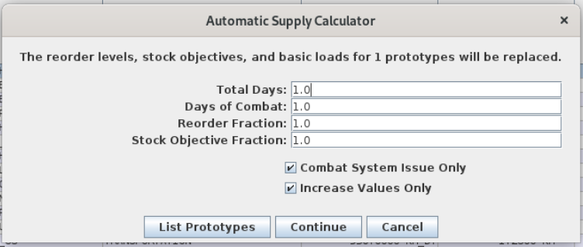
New Automatic Supply Calculation Tool
Complete redesign of the capability
More robust
More options
Means more time
to learn all
the features
Old capability

Slide 15
Past Automatic Supply Calculation Tool
Everything on one panel
  The panel appears simple
  User needed to understand JTLS-GO logistics in detail

Slide 16
New Automatic Supply Calculation Tool
Three types of Supply Calculations
  Supplies needed to support combat systems
  Supplies that represent consumption
    JTLS-GO is an operational level of war model
      Consumption and sustainment of an operation is important
      Consumption by personnel
      Consumption by vehicles
  Explicit supply usage
    Artillery
    Missiles
    Aircraft

Slide 17
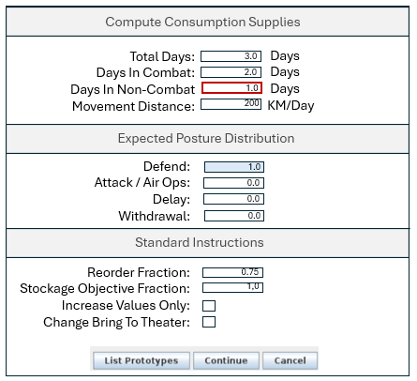
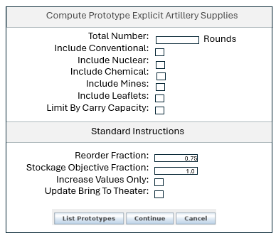
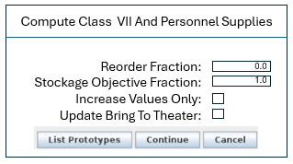
New Automatic Supply Calculation Tool
Separate panels for each Supply Calculation Type
Consumption
Explicit Supply Use
Combat Systems

Slide 18
New Automatic Supply Calculation Tool
Input
  Reorder Level %
  Stockage Objective %
  Posture Modifiers (attack, defend, delay, withdraw)
  Days of supplies
  Anticipated days in combat
  Movement distance per day
Output
  Basic Load
  Bring to Theater
  Reorder Level Value
  Stockage Objective Value

Slide 19

ROLEX COMAO
Composite Air Operations (COMAO)
  NATO Concept
    Never heard this concept from US air planners
  Not an air mission package
  Group of coordinated but independent missions
    Can be as many as 20 or 30 missions in a COMAO
ROLEX – Roll Execution
  Delay Execution
  Expedite Execution
  Cancel Execution
One order for all missions in COMAO

Slide 20
ROLEX COMAO
Cancel COMAO
  All missions canceled with the same reason
Expedite COMAO
  Enter Time Offset – Leave 30 minutes early
  Model recomputes:
    TOTs
    Launch times
    Refuel chit times
    Route specific times
    If missions will end up late
      Model will speed them up, if fuel is available, to meet new times

Slide 21
ROLEX COMAO
Delay COMAO
Enter Time Offset – Delay by 3 hours
Model recomputes:
  TOTs
  Launch times
  Refuel chit times
  Route specific times
Should active, flying missions be canceled?
  No: user needs to delay time somehow
  Yes:
    Mission automatically canceled
    New order needs to be manually entered

Slide 22
Phase 3 – JTLS-GO 6.4
To be completed by June
  ECPs requiring data changes
  ECPs with system changes
  Must retest for cybersecurity

Slide 23

Phase 3 – JTLS-GO 6.4
Better IIR Locations
  Previous SME guidance:
  “all objects reported in a DSA should have
  their location reported as the DSA center point”
  Adding Database Parameter: How To Report DSA Object Locations
    Actual object location
    Center point of DSA

Slide 24

Phase 3 – JTLS-GO 6.4
Better Naval Shadow Logic
  Problem all starts because of Formation handling
    Naval Formations are abstract - Not a real object
    Naval Formations can travel anywhere – even land
      Done to ease movement of true Naval vessels in Formations
    Ellen admits this was one of her worst
    JTLS-GO decisions
  The Solution
    A formation will not select a new location
    unless
      All ships can find a good station location
      If assigned station location is not good
        Ship will move closer and closer to
        formation center

Slide 25
Phase 3 – JTLS-GO 6.4
Better Naval Shadow Logic (Con’t)
  Extend logic to shadowing vessels
  Shadow Naval Unit or Naval Formation
  Can Show Naval Unit Or Naval Formation
    If next shadowing location is infeasible:
      Do not move closer to shadowed object
      Move to a different bearing if no enemy ships will be:
        Closer to shadowing vessel AND closer than shadow distance
      If no shadow location can be found:
        Go in wait state and ask for help

Slide 26

Phase 3 – JTLS-GO 6.4
Change Mission Type On Alert
  Allow missions to be placed on alert with ad-hoc tasking
  New mission type must be legal for the aircraft class
  Dependent on mission load
  What load can be used?
    If current load was defined in the order
      Load must be legal – no changes
    If current load selected by the model
      If mission is on alert at home base
        instantaneous load alteration
      If mission is on alert at forward operating location (FOL)
        Load must be legal – no changes
  Same logic for scheduled and pre-launch missions
    FOL restriction obviously does not apply

Slide 27

Phase 3 – JTLS-GO 6.4
Representing Swarms
  Not limited to UAVs
  A swarm is another aircraft group
    Air Mission Packages
      Different mission types
      Time coordinated group of missions
      Can start in different locations
      Travel to a closely coordinate area with
      closely coordinated time
    COMAO
      Different mission types
      Independent missions with a common group name
      Air planners responsible for coordinated time
    Swarm
      Different mission types
      Missions have same start times from same location
      Travel together
      Presumably, large number of aircraft
Notes:
illustration: HITANDRUN

Slide 28
Phase 3 – JTLS-GO 6.4
Representing Swarms
  Mission types legal in a swarm:
    OAS
    RECCE
    DCA Escort
    EC – Type Communications “Jamming”
      Must have a communication mission to direct the swarm
      If all aircraft in communication mission(s) aircraft are dead
        entire swarm dies
    New Mission Type – Decoy Mission
      Does nothing except increase size of swarm
      Adds to safety in numbers

Slide 29
Phase 3 – JTLS-GO 6.4
Representing Swarms
  Swarm formed via player order
    Similar to air mission package concept
    Parameter indicates if it is formed on land or in the air
  Missions defined separately
    Told they are part of a swarm
    Model ensures:
      Home squadrons are at same
        airbase, FARP, or naval unit
      Non-Squadrons – unit radius must overlap
    After missions are launch capable
      First task is to join the swarm (new JTLS-GO task type)

Slide 30
Phase 3 – JTLS-GO 6.4
Representing Swarms
  Mobility Missions
    Currently Can Load
      Supplies, Single Unit, Multiple HRUs
    Will Add Ability To Load
      Multiple Air Missions
        Load – everyone is on the ground
        Insert
          Mobility Mission airborne
          Missions will form a swarm and swarm starts to fly
        Extract
          Mobility Mission airborne (puts out a net and grabs the swarm)
          Missions will be on aircraft – swarm is canceled
        Offload
          Everyone back on the ground

Slide 31
Phase 3 – JTLS-GO 6.4
Representing Swarms
  Swarms have only two tasks
    Move
    Attack multiple targets
      Normal attack options for OAS missions
      The swarm does not separate
        Always travel together from target to target
  Other Non-Task Capabilities
    Swarm RECCE always collect intel on assigned targets
    Mobility Missions responsible for:
      Loading / Offloading / Insert / Extract Tasks
      Extract Task
        Mobility mission waits for swarm to be close – swarm has no choice
        Same as extract task for HRUs

Slide 32
Phase 3 – JTLS-GO 6.4
Representing Swarms
  Safety In Numbers
    Even if different aircraft types
    Kills are randomly selected from aircraft in the swarm
  Adjustments To
    Air-to-Air Algorithm
      Aircraft can fire on swarm – not on missions in the swarm
    Surface-to-Air Algorithm
      SAM sites can fire on swarm – not on missions in the swarm
  Missions cannot:
    Leave a swarm
    Cannot be split while in a swarm

Slide 33

Phase 3 – JTLS-GO 6.4
Container Units
  NATO Request – these are units without:
    Combat Systems
    Supplies
    Target
  Container Units Have
    Long Name, Short Name, C4I Name
    Symbol and Command Level
    Location
    Higher HQ
    Do not have a prototype

Slide 34
Phase 3 – JTLS-GO 6.4
Container Units
  Why?
    The JTLS-GO development team asked the same question
    Grouping Folders
      Seen in use as a JS/J7 JLVC Concept
      NATO appears to be adopting this concept
  New DDS Unit Table – For Container Units
    Is in the command hierarchy
    Will always arrive at time zero
      No TPFDD time in the database

Slide 35
Phase 3 – JTLS-GO 6.4
Container Units
  SVP warning if Top Unit on a side is not a container unit
    Container units will be perceived by all sides
    Currently it is a STARTEX order to tell all sides about top unit
      This is needed to start to perceive opposing force hierarchy
  Most orders will not allow entry of container units
    Change command hierarchy will allow a container unit
  Container units are always:
    At 100% strength
    In defend mission and posture

Slide 36

Phase 3 – JTLS-GO 6.4
Dual Mode SAM Fire Control / Acquisition Sensors
  Currently Surface-To-Air Missile (SAM) Sites
    Have a Fire Control (FC) Radar
      It is used only to guide the missile to the target
      It has no air search target acquisition capability
      This is not realistic
    Database solves acquisition problem
      Add acquisition radar owned by the SAM unit
      If FC sensor and acquisition are not the same piece of equipment
        Suppression and damage are not realistic
        If one is killed the other remains functioning

Slide 37
Phase 3 – JTLS-GO 6.4
Dual Mode SAM FC / Acquisition Sensors (Con’t)
  In JTLS 6.3, one sensor may be assigned several modes
    Any combination of:
      Air Search, Surface Search
      Active Sonar, Passive Sonar
      Counter-Battery
    Adding Fire Control Sensor to this list
  New SVP Errors / Warnings to accompany data changes

Slide 38
Phase 3 – JTLS-GO 6.4
Dual Mode SAM FC / Acquisition Sensors (Con’t)
  Implementation is simple
    Increased capability with assigned modes:
      Air Search Range – detect air objects
      Surface Search Range – detect surface(d) naval objects
      Active Sonar – detect surface and subsurface naval objects
      Passive Sonar - detect surface and subsurface naval objects
      Counter Battery – detect opposing force firing positions
  Remember the way JTLS-GO stays Unclassified
    No assumptions of real-world capabilities
    Flexibility of data – if the data allows it, it is possible

Slide 39

Phase 3 – JTLS-GO 6.4
Improve Destroying Satellites
  Currently no way to know satellite has been destroyed
    Its radius changes from search radius to debris radius
  Add new API attributes for Satellite Status
  Make this information available in:
    Satellite IMT
    Satellite SITREP
    Change Satellite Symbol
  Add new database parameter
    Destroyed Satellite Symbol

Slide 40

Phase 3 – JTLS-GO 6.4
WHIP Map Tile Server Integration
  NATO has funded the project
    Will require JTLS-GO cyber recertification from
    NATO
  Implementation supports Web Map Service protocol
    Organizations encouraged can use their own map server
    Important given various cybersecurity regulations worldwide
  Capability is optional
    Will preserve CADRG Capability
    Will remove GeoTIFF capability

Slide 41
Phase 3 – JTLS-GO 6.4
TPFDD Order Spreadsheet Capability
  Current Capability
    Implemented TPFDD In / Out of Theater for hierarchy
    No easy way to TPFDD several non-hierarchy units
  New Capability
    Implement Expanded TPFDD IMT
      Has all needed TPFDD data
    Select multiple units from TPFDD IMT
    Use IMT Spreadsheet capability to create:
      Manage TPFDD Order
      Review Spreadsheet
      Change As Needed, Such As TPFDD Time
      Send spreadsheet directly from WHIP

Slide 42
Phase 3 – JTLS-GO 6.4
Import JS/J7 Joint Tactical Data System OBS File
  Initial capability will be available in JTLS-GO 6.4.0.0
  Development plan moving forward
  Updates expected in each JTLS-GO 6.4 maintenance release during fiscal year 2025 – ending in September
  Next effort – Export OBS file from JTLS-GO end state

Slide 43
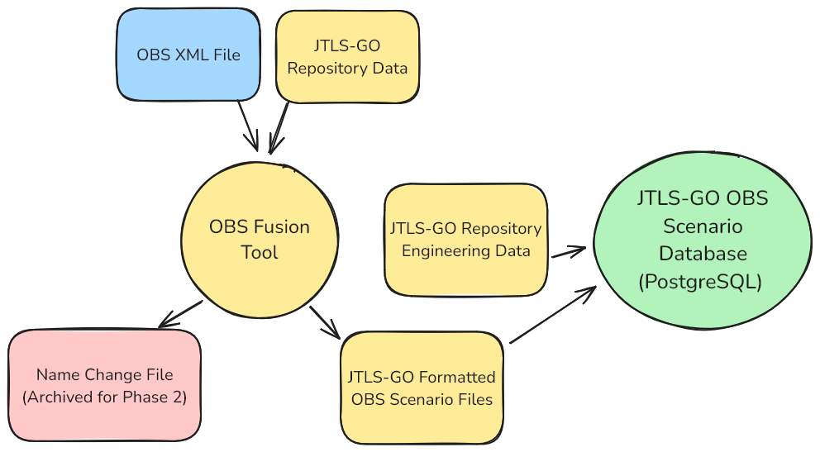
JLVC OBS Integration – Phase 1

Slide 44
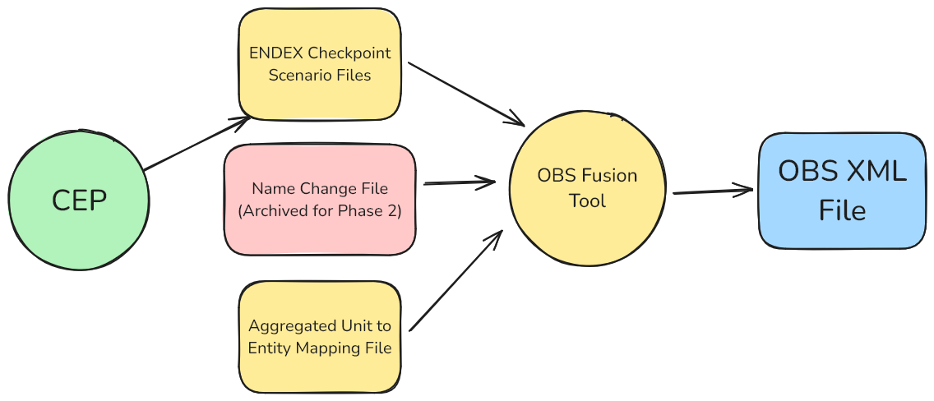
JLVC OBS Integration – Phase 2

Slide 45
Phase 3 – JTLS-GO 6.4
Representing Power Grid In JTLS-GO
  Won’t be done for initial delivery of JTLS-GO 6.4
  Considering adding data structures in the database
    Won’t need to wait for JTLS-GO 6.5
  Still under discussion and consideration

Slide 46
Operating System
Current Plan Is Red Hat 9.5
  For all practical purposes
    not backwards compatible
    not impossible, but limited (if any) such testing
  Demonstrations this week will be on Red Hat 9.5

Slide 47
Post JTLS-GO 6.4 Delivery Plans
Given new cybersecurity requirements:
  Need to deliver official version for cybersecurity tests
    June 20, 2025
  JTLS-GO does not want to lose agility
    Continued detailed testing throughout the summer
  Do not plan on using exercise ready JTLS-GO 6.4
    Until October 2025
May be getting funds to link to new US Air Planning system

Slide 48

Questions /
Discussion

