Slide 1
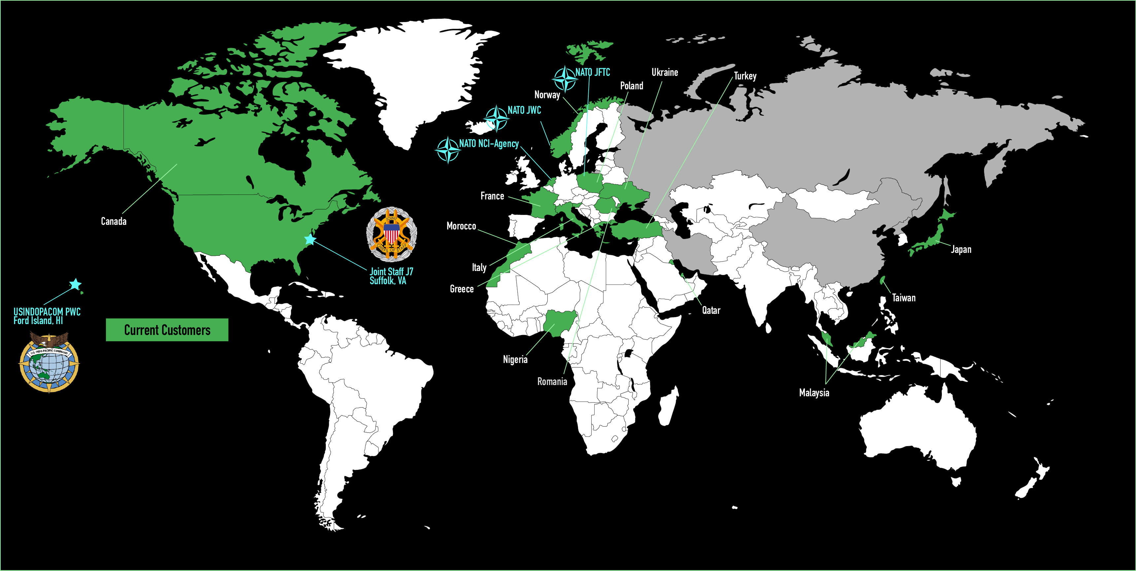
JTLS-GO Users (US & International)
Notes:
Potential New Clients 2026/27
Finland
Sweden
UK
Pakistan
Thailand
Egypt

Slide 2
Roadmap to display the investments and objectives for the next 2-3 years
2026
2027
2028
Exercise Support
Exercise Support
V6.5.0
V6.5.1
V6.5.2
V6.5.3
V6.5.4
V6.5.5
V6.5.6
V6.5.7
V6.5.8
V6.5.9
2025 NATO Enhancements
2026 NATO Enhancements
2027 NATO Enhancements
2026 JLVC Mod Upgrades - JTLS-GO light federation with JLVC
NATO NextGen
VE & ODU IRAD
JSJ7
INDOPACOM
JTLS-GO Multiple Playboxes
Allow Time Coordination Between Two JTLS-GO Games
Add imagery
Finalize JLVC OBS Functionality (JTLS-GO Fusion Tool) & Java 21 migration
Migrate to common Data Authority, Event Source (Kafka, gRPC)
WHIP 2.0 - Roles & Browser Supported
AI/ML – Scenario Generation, AAR data retrieval, chatbot
Containerization
Research New HADR Functionality
Repository Realignment
Undersea Infrastructure
Transition from SimScript to C++ or Java
DIS Interface, C2 Sys Int (KRADOS/C2CORE/AFATDS), Joint Simulation Tech Command Control (JSTC2) Integration and Testing Support
Backlog (CCB???)
26th Annual JTLS-GO International WG
NATO JWC Funding
JSJ7 JLVC Mod Funding (RDT&E)
JSJ7 (O&M)
INDOPACOM/PWC
Potential IRAD Funding
CLASSIFICATION (U)
Notes:
Investments
US, NATO, VE, INDOPACOM
International Users through SMSA contract
DEV Surge
ODU and PTOC support

Slide 3
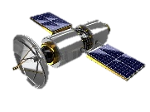
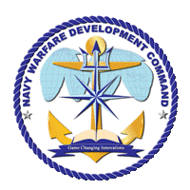













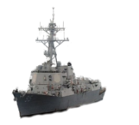


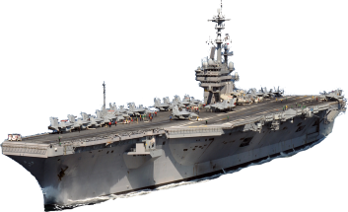


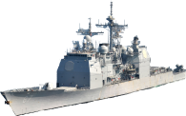

SITL-ET w/ DL
SITL-LV
USN LVC Multi Warfare Scenario
Distributed Virtual Constructive (Sims)
Adv Sims
Constructive
Constructive
Blue Sims
NWDC
FFVC
CSG-4
LVC Training Environment
Live Radar Contacts
E3
E2
Blue Standard Missiles
USS TRUXTUN
USS LABOON
USS GHW BUSH
Constructive FAC
Constructive
Adv Fighters
USS PHILIPPINE SEA
USS HUE CITY
Live Blue
Game control ashore
Supported ~150 synthetic contacts
5 platforms participated
Achieved all criteria for at see synthetic training
Constructive Blue
Live Adversary
Link 16 DL
Virtual Blue
Link 16 DL
Const Adversary
NCTE
Constructive White
LATR

Slide 4







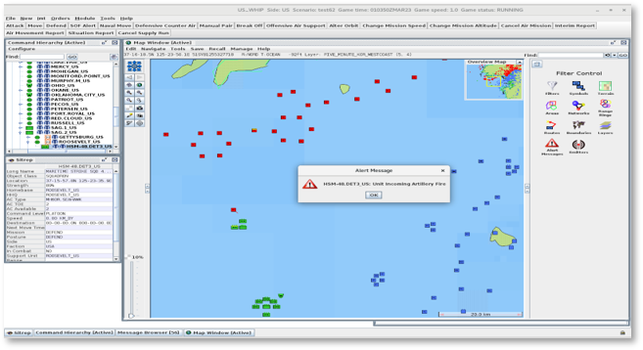
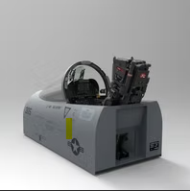

LVC Needs, Desires, and Possibilities
LVC Expertise is based in developing the US Navy’s current capabilities
Includes the integration of this environment to USCENTCOM, USEUCOM, USPACOM, and USNORTHCOM exercises and certifications
  US/NATO/Coalition Land, Maritime, Air, and Space Forces
Each section of the wheel has different technical challenges, safety requirements, and interaction needs(requirements)
Communication and C2 architecture considerations (Ops vs Trng)
Integrated Live Red & Constructive Air
Integrated Live Red and Constructive Surface
Live RED AIR
Live BLUE AIR
Live RED
Live Blue
Virtual
Constructive
LVC Integration Wheel
ACS has solid LVC caps for at-sea mission rehearsal and training
Notes:
Valkyrie’s team can help you navigate the challenges and make the most cost- effective recommendations to meet your needs.
Valkyrie has developed an implemented major changes to high-cost communications architectures, to developing low-cost special boxes to create new training capabilities, down to no-cost simulation techniques (slightly altering how the simulation is used) to create new presentations to the training audience.

Slide 5
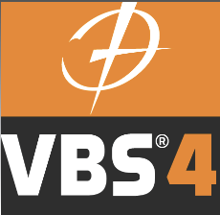


Continued Partnership
VBS4 – Joint Effort Between BiSIM and Valkyrie
Links JTLS-GO with BISim’s VBS4 Simulation
Provides a Theater-Level Constructive Simulation (JTLS) with a High-Resolution, Entity-Level Constructive Simulation – OPERATIONAL to TACTICAL Level of War
Provides an Accurate View of the JTLS-GO Theater as Seen by a UAV (International or US Clients)
  Displays All JTLS-GO Objects (Ground, Ships, Convoys & Air) and the VBS-4-Owned UAVs
MUSE – Multiple Unified Simulation Environment
Provides High Resolution Simulation System that Represents Unmanned Aerial Vehicles (UAVs)
Provides an Accurate View of the JTLS-GO Theater as Seen by a UAV (US Clients)
  Displays All JTLS-GO Objects (Ground, Ships, Convoys & Air) and the MUSE-Owned UAVs
National War Gaming Simulation - Next Generation (NWARS-NG)
Provides High Resolution Simulation System that Represents Overhead Intelligence Information From the JTLS-GO Theater Bellow
GlobalSim – Joint Effort Between CAE and Valkyrie
Combines Joint Theater-Level Simulation (JTLS) with the GESI Command and Staff Training System
Provides a Theater-Level Constructive Simulation (JTLS) with a High-Resolution, Entity-Level Constructive Simulation (GESI) – OPERATIONAL to TACTICAL Level of War
Creates a Comprehensive HLA Federation that Offers Command Leadership a Single, Realistic, Multi-Resolution View of the Complete Operational Environment

Slide 6
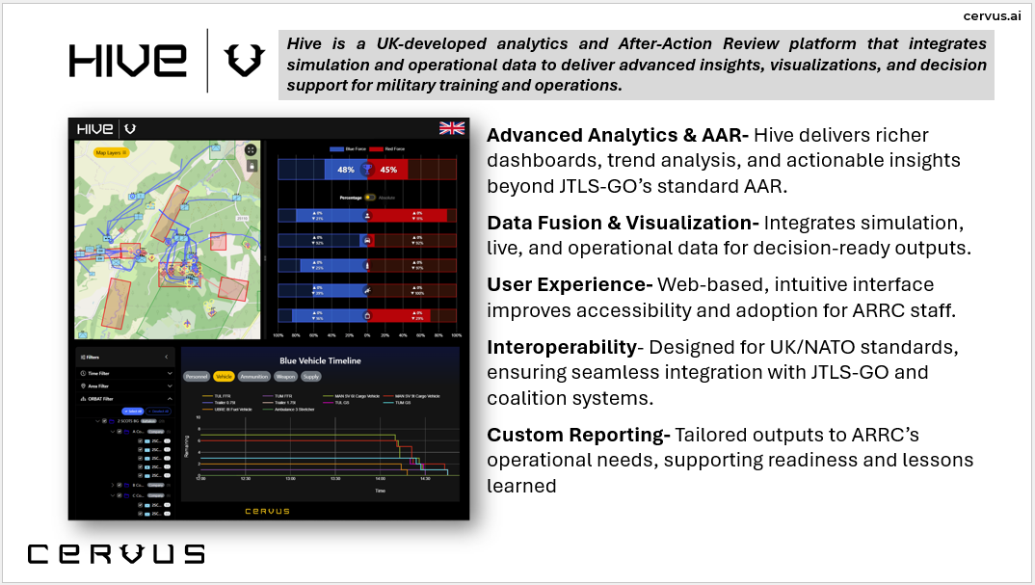
New Partnership in 2025 - Cervus

Slide 7
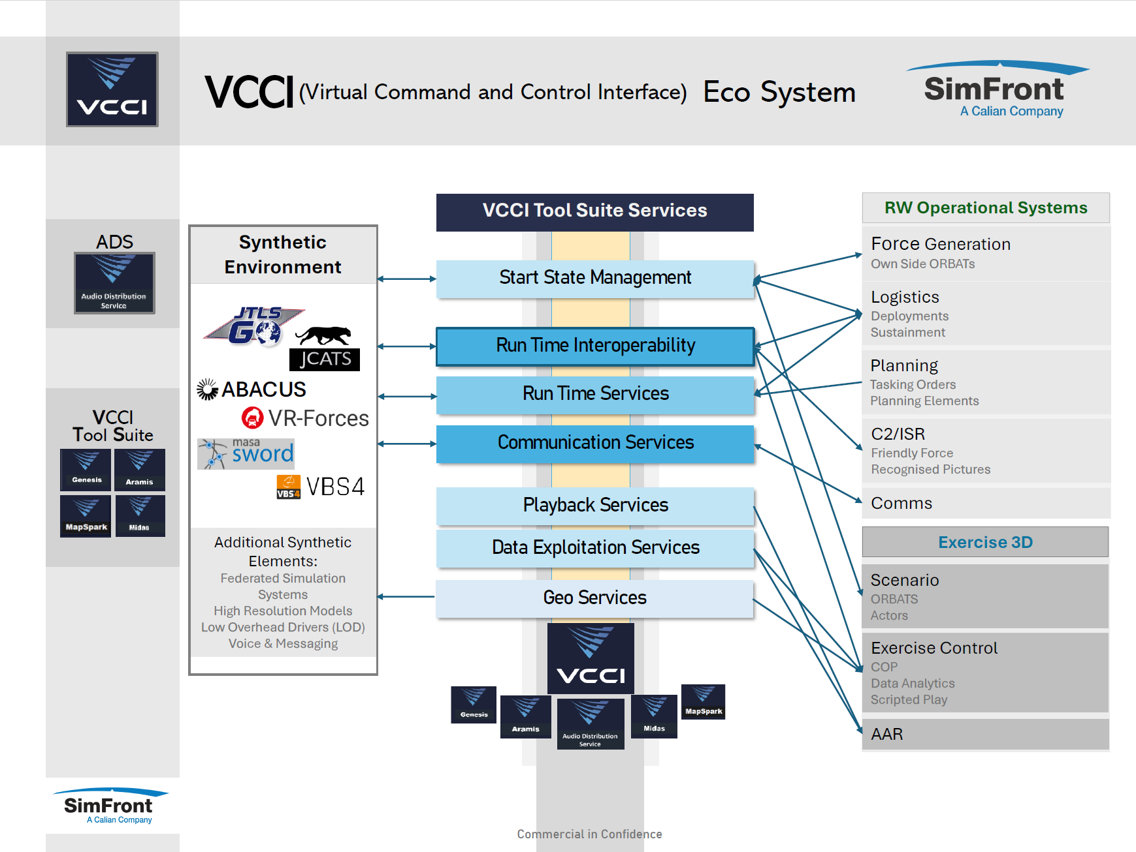
Continued partnership with Calian - VCCI

Slide 8

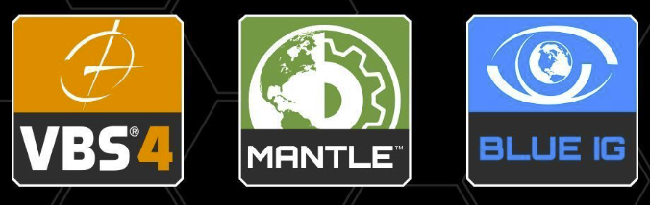
Renewed Partnership with OneArc 2025

