Slide 1


Current Status of JTLS-GO Releases
Eric McDonald, Director of Development
19 May 2026

Slide 2
Agenda
Development Team
Event Cadence
Release Versioning
Current Release Support
Reminders
Closing & Questions

Slide 3
JTLS-GO Development Team
Eric McDonald | Director, Frontend, Support Tools and Services, Systems Design
Ellen Roland | Chief Model Engineer, Systems Design
Vance Southern | Operations and Support Manager, Scenario Development
Dr. Donna Womble | Model Development, Entity Level Server, Federation Support
John Hertz | Model Development
Harold Yamauchi | Model Development, Support Tools and Services

Slide 4
JTLS-GO Development Team
Zafer Aktan | Database Schema Design and Administration
Dr. Steve Tang | Systems Backend, Security, Systems Design
Jane Wu | Database Frontend
Jose Torres | WHIP Frontend
Bill Lynn | Federation Support, Backend Systems, and Support Tools
Caspian Forsyth | Testing, Documentation, Senior Control
Rick Kalinyak | Part Time Senior Resource

Slide 5
JTLS-GO Development Team – New Additions
Kyle Batalla | Frontend
Sean Wells | Infrastructure, Systems
Joanne Kim | Model Development
Mike Gabino | Operations, Scenario Development

Slide 6
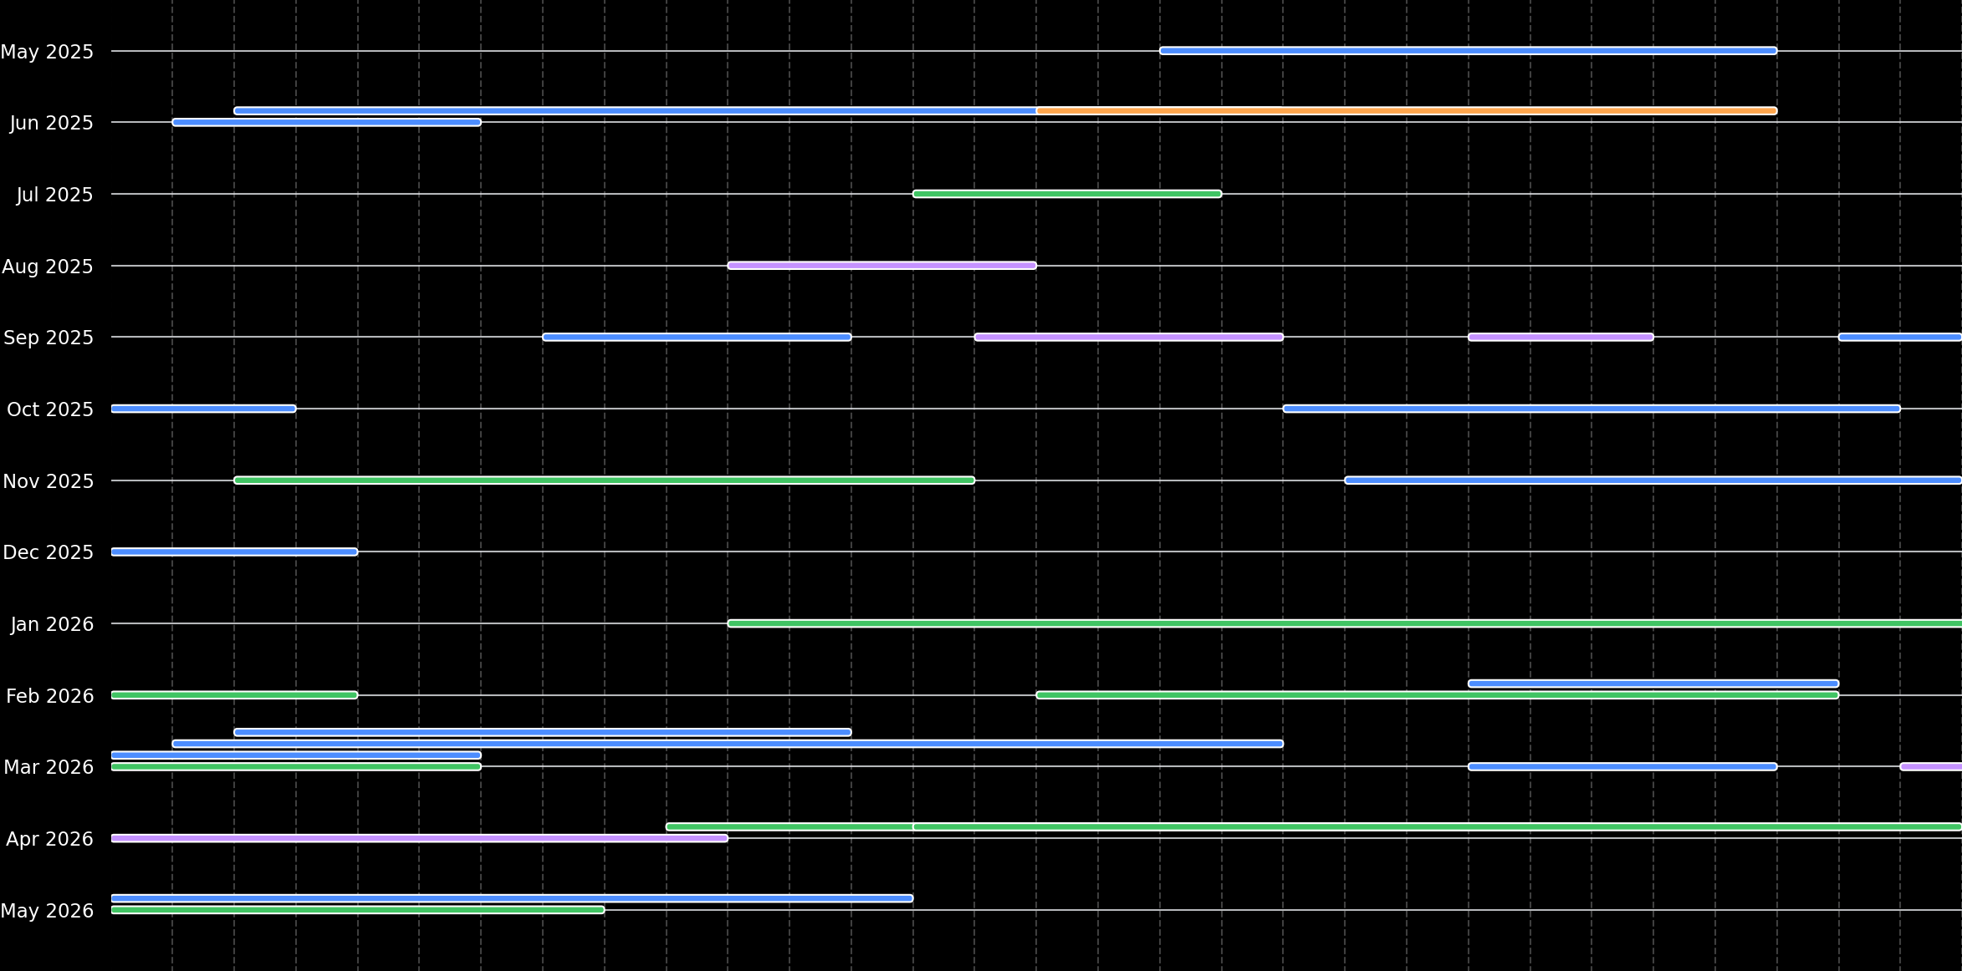
Event Cadence
Notes:
18 May - 27 May 2025: Steadfast Deterrence
2 June - 6 June 2025: NDU Warsaw Training
3 June - 19 June 2025: CWIX
16 June - 27 June 2025: Malaysia Training
14 July - 18 July 2025: USINDOPACOM Database Training
11 August - 15 August 2025: JTLS-GO 6.4 OAT
8 September - 12 September 2025: NATO JWC Steadfast Duel Orbat Validation Test
15 September - 19 September 2025: JFT Testing at JSJ7
23 September - 25 September 2025: CAX Forum in Rome
29 September - 3 October 2025: Ecole de Guerre Training
20 October - 29 October 2025: Steadfast Duel
3 November - 14 November 2025: USINDOPACOM Training in Japan and Korea
21 November - 4 December 2025: Steadfast Dagger
11 January - 4 February 2026: Keen Edge
16 February - 6 March 2026: Cobra Gold
23 February - 6 March 2026: NATO ACO SHAPE Research
2 March - 19 March 2026: Cold Response
3 March - 12 March 2026: Loyal Leda
23 March - 27 March 2026: CJWC Future Force Exercise
30 March - 10 April 2026: Ukrainian Training in Monterey
10 April - 24 April 2026: Taiwan Exercise
14 April - 8 May 2026: Balikatan
1 May - 13 May 2026: Steadfast Deterrence

Slide 7
6.4.3.1
Flagship.Major.Minor.Interim

Slide 8
Flagship.Major.Minor.Interim (6.4.3.1)
Flagship version
Fundamental, underlying technology changes
JTLS-GO 5.0
    Removed Hexagon Terrain – Used Grid Terrain
  JTLS-GO 6.0
    Simscript III
    Moved to PostgreSQL from Oracle
Requires planning to adopt and understand changes
    Possibly a few months
  Not backward compatible
    Database format changes
      Database conversion tool provided (VCP)
    JDSP object structure changes
      Breaking API changes
  VDD delivered
  Announcement via distribution email

Slide 9
Flagship.Major.Minor.Interim (6.4.3.1)
Major version
  Not backward compatible
  Model and system Improvements
  Database format changes
    Database conversion tool provided (VCP)
JDSP object structure changes
    Breaking API changes
  Should plan a few weeks adoption time
  VDD delivered
  Announcement via distribution email

Slide 10
Flagship.Major.Minor.Interim (6.4.3.1)
Minor version
Backward compatible features and fixes
Quarterly maintenance releases of 3rd Party tools (Java, Postgres, Apache)
Configuration changes, code fixes, small improvements
No database format changes
No breaking JDSP API changes
No need to worry about linked software
    Errors may have been fixed in the JDSP API
    Make sure to read Chapter 1 of Version Description Document (VDD)
Adoption of Minor versions can be immediate
Recommendation to use the newest/best available
  VDD delivered
  Announcement via distribution email

Slide 11
Flagship.Major.Minor.Interim (6.4.3.1)
Interim version
Bug fix release, backward compatible
Solve immediate problem of specific user
Bring latest version to an exercise
No announcement via distribution list
No formal VDD delivered
If you have an upcoming exercise:
  Review rolands.com 0Readme (changelog) for critical fixes
  Ask help desk for list of fixes since last Minor release
  Just ask for an Interim release – we can make one for your exercise

Slide 12
Breaking Changes
Database changes
JDSP API changes
Only worry about first two digits
6.4.3.1

Slide 13
Current Release Support
6.3 – Expected EOL June 2026
    Latest: 6.3.9.0, March
6.4 – Current Release
    Latest: 6.4.4.0, April
    JS/J7 Operations & Maintenance Task
    Support ends 12 months after release of JTLS-GO 6.5
  6.5 – Under work – anticipated June 2026

Slide 14
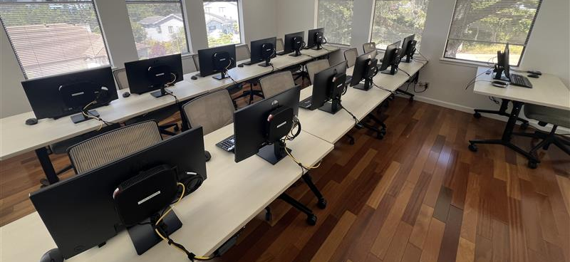
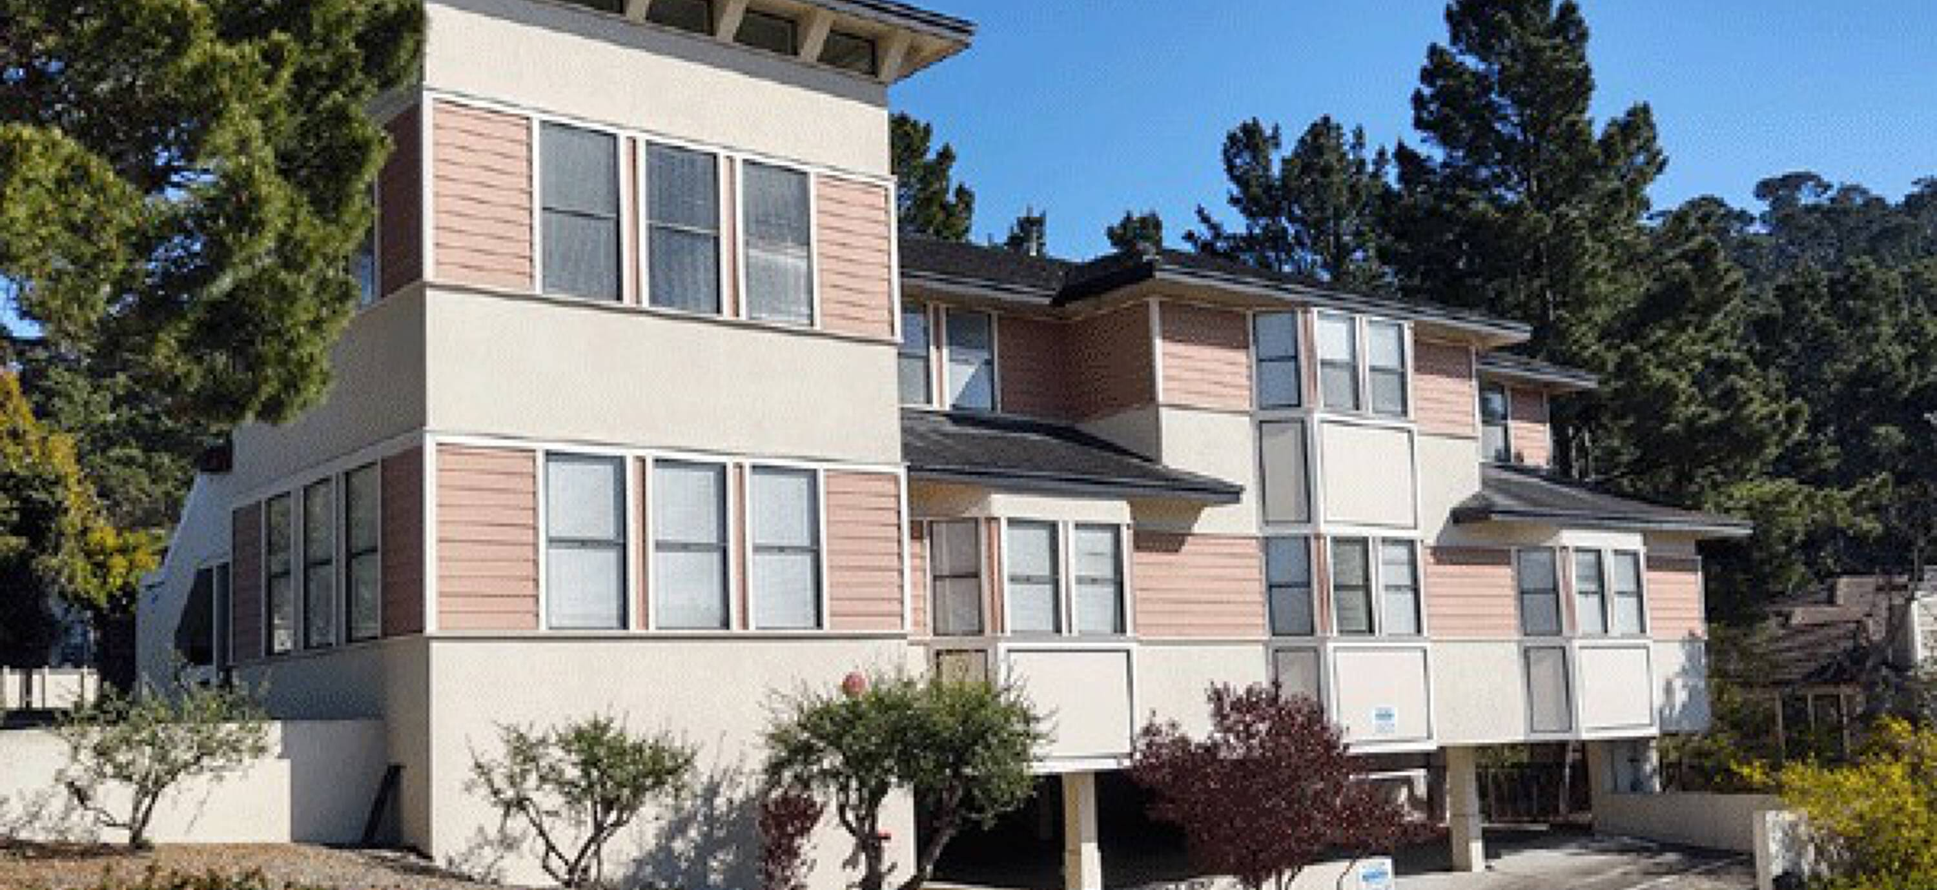
Reminder
New Facility in Pacific Grove
Virtualized environment
Training Room Update
  Virtualized machines
  Thin clients at each station
  More efficient management of versions
  Easier to meet training needs
  Remote training environment access
  🔗classroom.rolands.com

Slide 15
Reminder - Ticketing System
Detailed tracking and more transparent responses
Quicker notification of user communications
Collaborative management for the whole team
  🔗jtlshelpdesk.valkyrie.com
  📧jtlsgo@valkyrie.com

Slide 16

{Questions}

