Slide 1
Joint Theater Level Simulation JTLS
© ROLANDS & ASSOCIATES Corporation

Slide 2

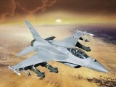
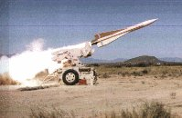
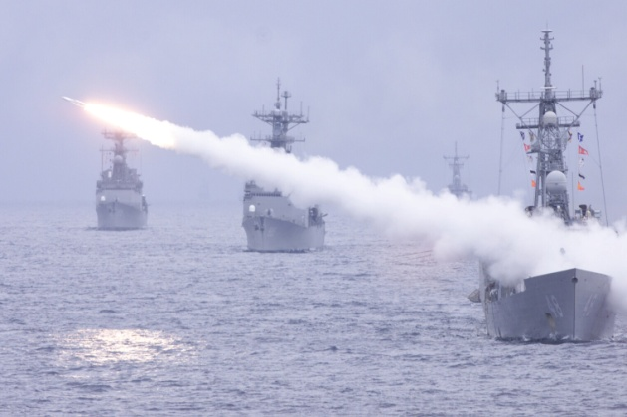
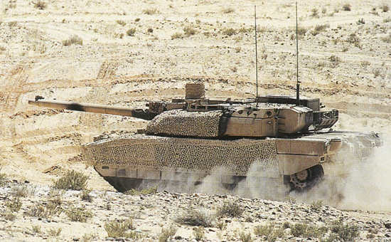
Common Simulation Battlefield
• Training
• Operations Analysis
• Planning
Real World Operations

Slide 3
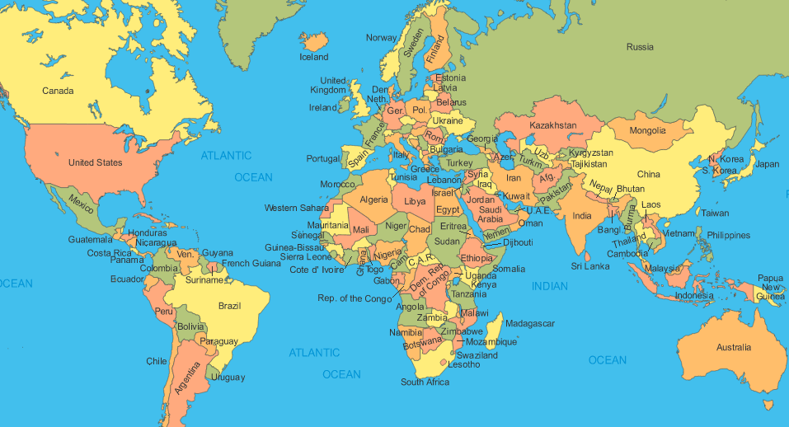
JTLS Around the World
Norway
JWC
JFTC
NICA
Poland
United Kingdom
Slovenia
France
Japan
Turkey
Rep of Korea
JCS
Spain
Italy
Greece
Taiwan
Pakistan
Saudi Arabia
UAE
Thailand
Malaysia
Australia

Slide 4
JTLS Levels of Support
- Constructive Simulation
- Operational Level (Joint)
- Highly Aggregated Forces
Training \ Exercise
Political
Levels of War
Strategic
Analysis
A
C
Q
U
I
S
I
T
I
O
N
Operational
O
P
S
S
U
P
P
O
R
T
Tactical
C/C
Air
Navy
Component
Functional Areas
Army
Notes:
4
4

Slide 5
Analysis
- Constructive Simulation
- Operational Level (Joint)
- Highly Aggregated Forces
Training Exercise
Political
Levels of War
Strategic
Analysis
A
C
Q
U
I
S
I
T
I
O
N
Operational
O
P
S
S
U
P
P
O
R
T
Tactical
C/C
Air
Navy
Component
Functional Areas
Army
Notes:
5
5

Slide 6
Ops Support
- Constructive Simulation
- Operational Level (Joint)
- Highly Aggregated Forces
Training Exercise
Political
Levels of War
Strategic
Analysis
A
C
Q
U
I
S
I
T
I
O
N
Operational
O
P
S
S
U
P
P
O
R
T
Tactical
C/C
Air
Navy
Component
Functional Areas
Army
Notes:
6
6

Slide 7
Training / Exercise
- Constructive Simulation
- Operational Level (Joint)
- Highly Aggregated Forces
Training Exercise
Political
Levels of War
Strategic
Analysis
A
C
Q
U
I
S
I
T
I
O
N
Operational
O
P
S
S
U
P
P
O
R
T
Tactical
C/C
Air
Navy
Component
Functional Areas
Army
Notes:
7
7

Slide 8
Scalable Simulation
Supports a Spectrum of Conflict spanning security cooperation, contested stability operations, irregular warfare, hybrid warfare and major conventional and non-conventional operations
Operations
War
Operations Other Than War
General Goal
Win / Enemy
Destruction
Deter War &
Resolve Conflict
Promote / Enforce
Peace
Large Scale Combat Ops
Attack
Defend
Blockade
Peace Enforcement
Spt Counterinsurgency
Counterterrorism
NEO
Raid
Strike
Peacekeeping
Counterdrug
Human. Assistance
Disaster Relief
Nation Assistance
NEO
Civil Support
Examples
Notes:
8

Slide 9
Force Side Relationships
Non-Symmetric
Based on Perceptions
Reflect s Real World Complexities
Blue
Forces
Affects Force Interactions
Coalition Air Operations
Joint Naval Operations
Lanchester Combat
Coalition Logistics
Sharing Intelligence
Others
Red
Forces
White
Forces
Orange
Forces
Notes:
Introduction To JTLS
October 2009
ROLANDS & ASSOCIATES Corporation
9

Slide 10
Force Side Relationships
Non-Symmetric
Based on Perceptions
Reflect s Real World Complexities
Blue
Forces
Enemy
Airdrop supplies
Enemy
Red
Forces
Enemy
Enemy
White
Forces
Orange
Forces
Enemy
Notes:
Introduction To JTLS
October 2009
ROLANDS & ASSOCIATES Corporation
10

Slide 11
Force Side Relationships
Non-Symmetric
Based on Perceptions
Reflect s Real World Complexities
Blue
Forces
Suspect
Provide supplies
Permit use of MHE
Provide or receive translators
Combat overwatch a unit or target
Permit gathering/reporting of diseases
Enemy
Red
Forces
Enemy
Suspect
Enemy
White
Forces
Orange
Forces
Enemy
Notes:
Introduction To JTLS
October 2009
ROLANDS & ASSOCIATES Corporation
11

Slide 12
Force Side Relationships
Non-Symmetric
Based on Perceptions
Reflect s Real World Complexities
Blue
Forces
Neutral
Airlift supplies
Airlift unit
Amphibious operations w/Unit
Join naval formations
Enemy
Red
Forces
Enemy
Suspect
Neutral
Neutral
Enemy
White
Forces
Orange
Forces
Enemy
Friend
Notes:
Introduction To JTLS
October 2009
ROLANDS & ASSOCIATES Corporation
12

Slide 13
Force Side Relationships
Non-Symmetric
Based on Perceptions
Reflect s Real World Complexities
Blue
Forces
Friendly
Transfer aircraft shelter
Transfer aircraft
Join air mission packages
Provide CAS support
Provide Air Refueling
Enemy
Red
Forces
Enemy
Suspect
Neutral
Friendly
Neutral
Friendly
Enemy
White
Forces
Orange
Forces
Enemy
Friend
Notes:
Introduction To JTLS
October 2009
ROLANDS & ASSOCIATES Corporation
13

Slide 14
Scenario Activities
Operations
Environment
Air
Land
Political
Economic
Sea
Medical
Reconnaissance
Legal
Fires
Personnel
Maneuver
Media
Conflict Resolution
Logistics
Computer
Model
Master Scenario
Events List
Master Scenario
Events List
Computer
Model
Notes:
14

Slide 15
Wargaming Organization
CINC
Role Players
JTF/JOINT STAFF
Primary Training Audience
JSOTF/STAFF
CINC/JTF
Air Force Staff
CINC/JTF
Army Staff
CINC/JTF
Navy Staff
CINC/JTF
Marine Staff
Response Cell
SOF
Components
Air Force
Component
Army
Component
Navy
Component
Marine
Component
Computer Model

Slide 16
Basic Exercise Concept
MSEL
Scripting
Headquarters
Staff
Exercise Control
Group
Response
Cells
Service
Component
Staffs
C⁴ I Systems
The Model: JTLS
Training Audience
Opposition Force
Notes:
June 2011
Copyright 2011, ROLANDS & ASSOCIATES Corporation
16

Slide 17
Typical JTLS Wargame/CPX Setup
JTF
Level
JTF COP - C2PC
Training Audience
Message
System
JTF
Reports/
Returns/
Phone
Email
JFMCC
JFLCC
JFACC
JSOF
JLOG
Component COPs -
C2PC
Component
Level
Training Audience
Message
System
Phone
Email
Embellished
Formatted
Reports/ATO
Tactical Level
Units,
Squadrons
Ships
OTH-G
Track Data
Stream
Exercise
Control
Group
EXCON
Formatted
Reports
JOI
Message
Browser
JTLS
Notes:
17

Slide 18
CAX “Machine”
CAX
Objectives
Training
EXCON
Audience
Lessons
Learned
Lessons
Learned
JTLS TOOLS
Lessons
Learned
J T L S
S U I T E

Slide 19
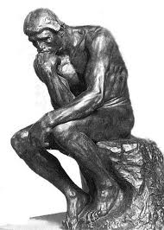
Questions

